Slide 1


JSPM’s
Rajarshi Shahu College of Engineering, Tathawade, Pune
(An Autonomous Institute affiliated to Savitribai Phule Pune University)
Department of Computer Science and Business Systems
Academic Year: 2026-27
Project Title:
Customer Relationship Management (CRM) System
Student Name : 1.Harish Dandekar (RBT25CB006)
2.Sanskar Gaikwad 119RBT25CB009)
Date: 14 October 2026
Course Name: Database Management System
Course Coordinator: Prof. Rutuja S. Bachhav

Slide 2
Index
01 Introduction / Background
02 Problem Definition & Objectives
03 Literature Survey
04 Feasibility Study
05 System Design & Architecture
06 Database Design & ER Diagram
07 SQL Implementation & Results
08 Conclusion
09 References

Slide 3
Introduction / Background
• Customer Relationship Management (CRM) is a system for organizing customer data and tracking sales-related activities.
• This project provides a web-based interface to manage Customers, Employees, Leads, Products, Deals and Interactions in one place.
• Domain context: CRM supports better customer follow-up, visibility of sales opportunities and consistent record keeping.
• Technology stack: HTML, CSS and JavaScript for the frontend; Node.js and Express for the backend; MySQL for persistent storage.

Slide 4
Problem Definition & Objectives
Problem definition
• Customer and sales information can become scattered across files or separate records, making updates and follow-ups difficult.
• The project needs a structured database and a simple interface to create, view, update and delete records while preserving relationships.
Objectives
• Centralize six CRM entities in a relational database.
• Apply primary keys, foreign keys and constraints to maintain data integrity.
• Expose database operations through backend API endpoints.
• Provide a straightforward interface for managing CRM records and demonstrating DBMS concepts.

Slide 5
Literature Survey
• Relational database systems organize information into tables and connect related records through keys.
• Primary keys uniquely identify rows; foreign keys enforce valid references between related tables.
• CRUD operations (Create, Read, Update, Delete) are the basic operations expected in a record-management application.
• REST-style APIs separate the user interface from database access and allow the frontend to request operations from the backend.
• Project application: MySQL stores the CRM data, while Node.js/Express handles requests from the browser.

Slide 6
Feasibility Study
Technical feasibility
• Uses commonly available tools: HTML/CSS/JavaScript, Node.js, Express, mysql2 and MySQL.
• Runs locally on the development computer at http://localhost:3000.
Financial / business feasibility
• The core software stack is available at no additional licensing cost for this academic prototype.
• A centralized CRM can reduce duplicate data entry and improve visibility of customer and sales records.
Operational feasibility
• A browser-based interface is familiar to users and supports routine record management.
• Referential integrity prevents deleting a customer when dependent deal records still reference that customer.

Slide 7
System Design & Architecture
Frontend
HTML • CSS
JavaScript
Backend API
Node.js
Express routes
DB Driver
mysql2
Query execution
Request flow
1. User action in browser → 2. Express API receives request → 3. mysql2 executes SQL → 4. MySQL returns data.
The API responds with JSON; the frontend updates the displayed records and shows success/error messages.
MySQL Database
CRM tables
Keys & constraints

Slide 8
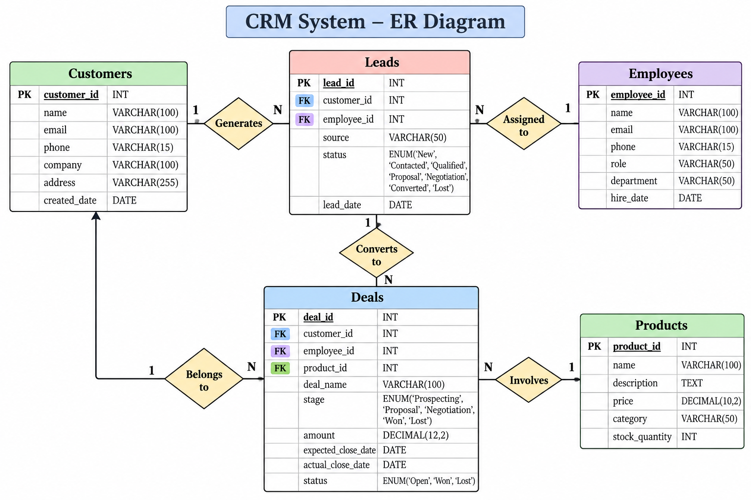
Database Design & ER Diagram
PK = Primary Key | FK = Foreign Key • Leads, Deals and Interactions reference customer and employee records. Product-to-deal line is illustrative; confirm/add a product FK if implemented.

Slide 9
SQL Implementation & Results
Database implementation
• MySQL stores the six CRM entities in related tables.
• Keys and constraints support unique identification and referential integrity; fields use appropriate types such as INT, VARCHAR, ENUM and DECIMAL where applicable.
Application implementation
• HTML/CSS/JavaScript frontend communicates with Node.js/Express API routes.
• mysql2 connects the backend to the local MySQL database; API responses are returned as JSON.
Demonstrated results
• Record listing and CRUD operations are available through the CRM interface.
• Deleting a customer referenced by a deal is rejected by MySQL, demonstrating foreign-key enforcement.

Slide 10
Conclusion
• The CRM mini project demonstrates how a relational database can support organized customer and sales management.
• The frontend, Express API and MySQL database are connected in a working local application.
• The project applies DBMS concepts including tables, primary keys, foreign keys, constraints and CRUD operations.
• Future enhancements: role-based login, search/filtering, sales reports, validation, audit logs and deployment to a shared server.

Slide 11
References
1. MySQL Documentation — https://dev.mysql.com/doc/
2. Node.js Documentation — https://nodejs.org/docs/
3. Express.js Documentation — https://expressjs.com/
4. MDN Web Docs — HTML, CSS and JavaScript — https://developer.mozilla.org/
5. Course: Database Management System, JSPM’s Rajarshi Shahu College of Engineering.
6. Project implementation: CRM frontend, Node.js/Express API and MySQL database developed for the DBMS mini project.

